Slide 1
The Stations of the Cross
Using this service we will follow through the last days in the
life of our Lord and as we seek to die with Christ so may we
also rise to new life on Easter Sunday.
We are especially grateful for kind permission to
reproduce the Station of the Cross from Renhold Parish
Church, Bedford, made by prisoners in Bedford Prison
Jesus said.
‘If any want to become my followers, let them deny
themselves and take up their cross and follow me...’

Slide 2
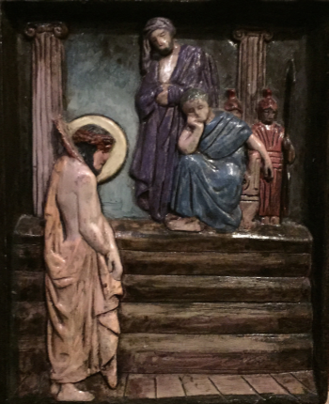

Slide 3
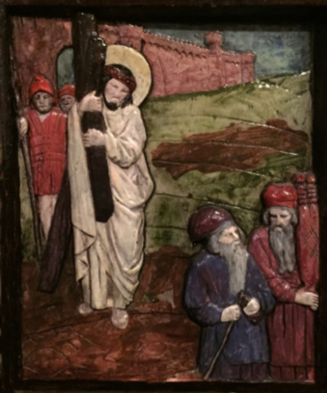

Slide 4
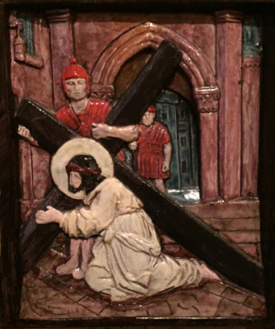

Slide 5
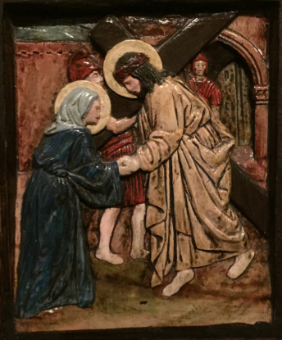

Slide 6
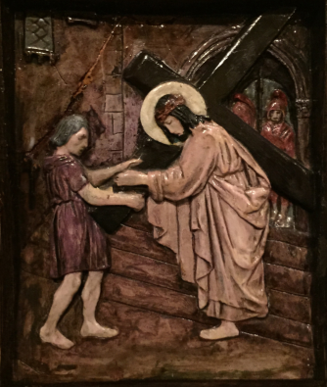

Slide 7
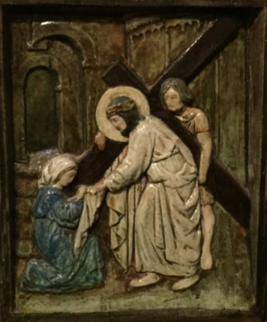

Slide 8
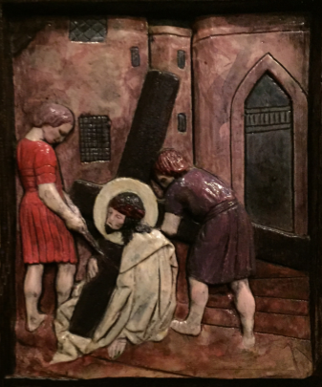

Slide 9
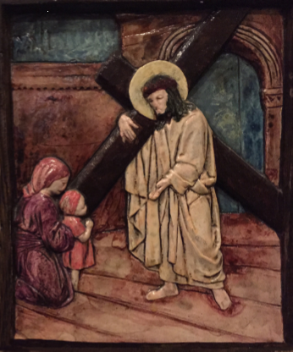

Slide 10
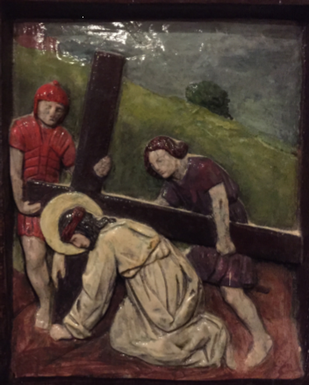

Slide 11
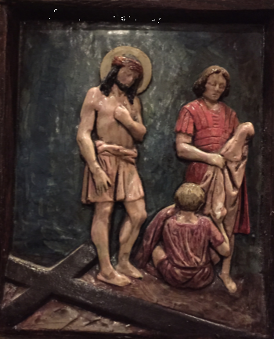

Slide 12
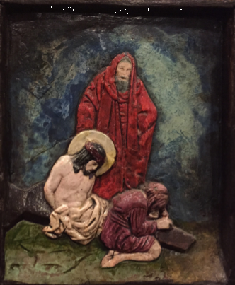

Slide 13
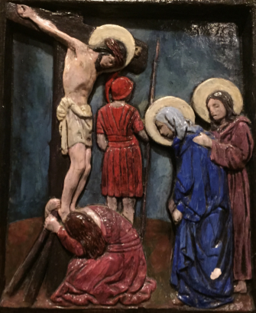

Slide 14
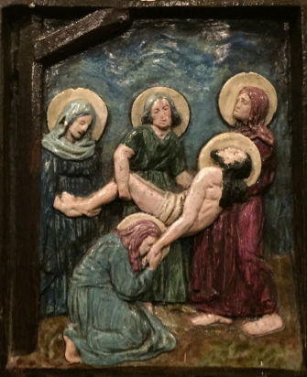

Slide 15
